Slide 1
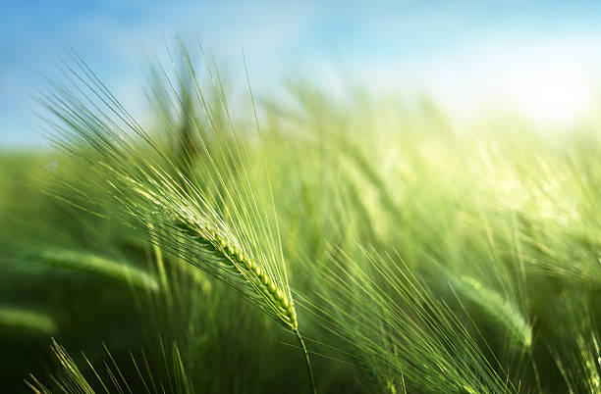
AGRONOMY
Presented By:
Prashant Rana
1NH17CS099

Slide 2
INTRODUCTION
Agronomy is the science of soil study and production of crops.
This project is about providing support to farmers in production of crops by suggesting suitable crops according to their location and the weather condition.

Slide 3
OBJECTIVES
Although the technology has developed so much, there is very less prioritization on agriculture.
So, this project is aimed to help the farmers choose suitable crops, pesticides and equipment according to their location’s climate and soil fertility.
This project will help in effective utilization of crops by preventing losses of crops.

Slide 4
PROBLEM STATEMENT
Ideally this application would be able to collect all the data of climate and weather of any place and give suggestions on improving cultivation.
In reality, not many weather forecasting applications are developed focusing on agriculture.
Here, we use Web Scrapping to extract the data from weather forecasting sites and database for storing data.

Slide 5
COMPONENTS OF AGRONOMY
Weather Condition
Crops
Soil condition
Other requisites for cultivation of crops
Pesticide
Equipment

Slide 6
Weather, Crops and Soil
Cultivation solely depends on weather and soil condition, so we need the current weather condition for any given location and its soil condition to perform the given calculation.
Through the temperature, rainfall, humidity and soil fertility we can predict the current status of your area and suggest crops according to it.

Slide 7
Web Scraping and Crawling
Web scraping is a method of processing a web document and extracting information out of it.
While web crawling is a process of creating an automated script which browses the World Wide Web in a methodical, automated manner.
Steps involved in web scraping:
Request the site for data
Parse the response into html or xml form
Extract the data
Store into file

Slide 8
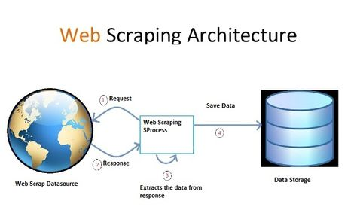
Web Scraping and Crawling

Slide 9
Web Scraping and Crawling
Some of the libraries for web scraping and crawling in python are:
Requests
Beautiful Soup 4
lxml
Selenium
Scrapy
This program is implemented using Requests , Beautiful Soup 4 and Selenium libraries for web scraping.

Slide 10
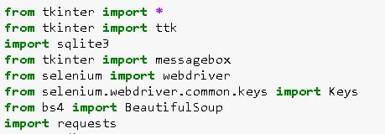
IMPLEMENTATION
Libraries used:
Tkinter is used for GUI, sqlite3 is used for using sql commands to store data in database and requests, selenium and bs4 are used for web scraping.

Slide 11
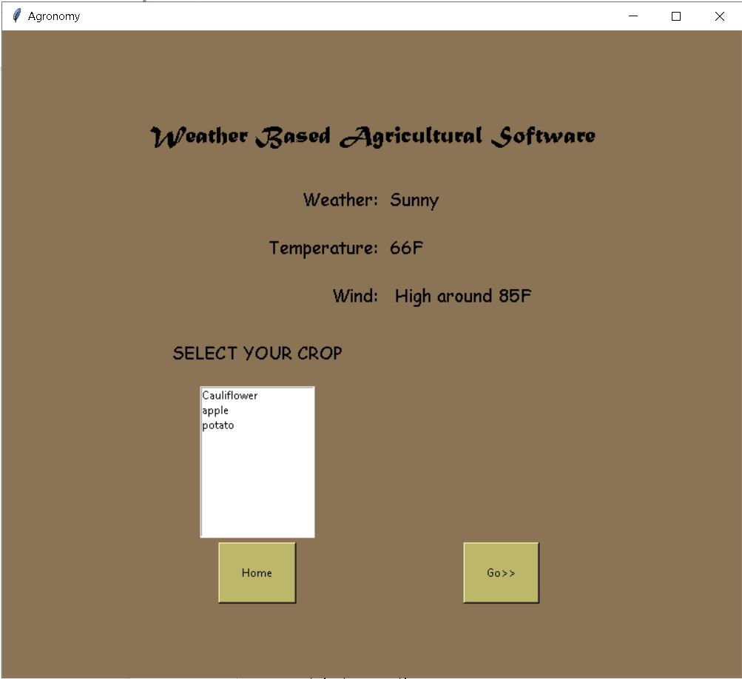
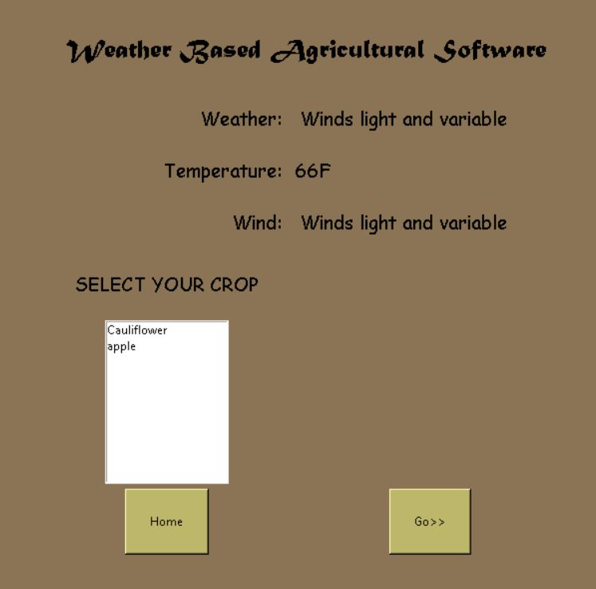
OUTCOME

Slide 12
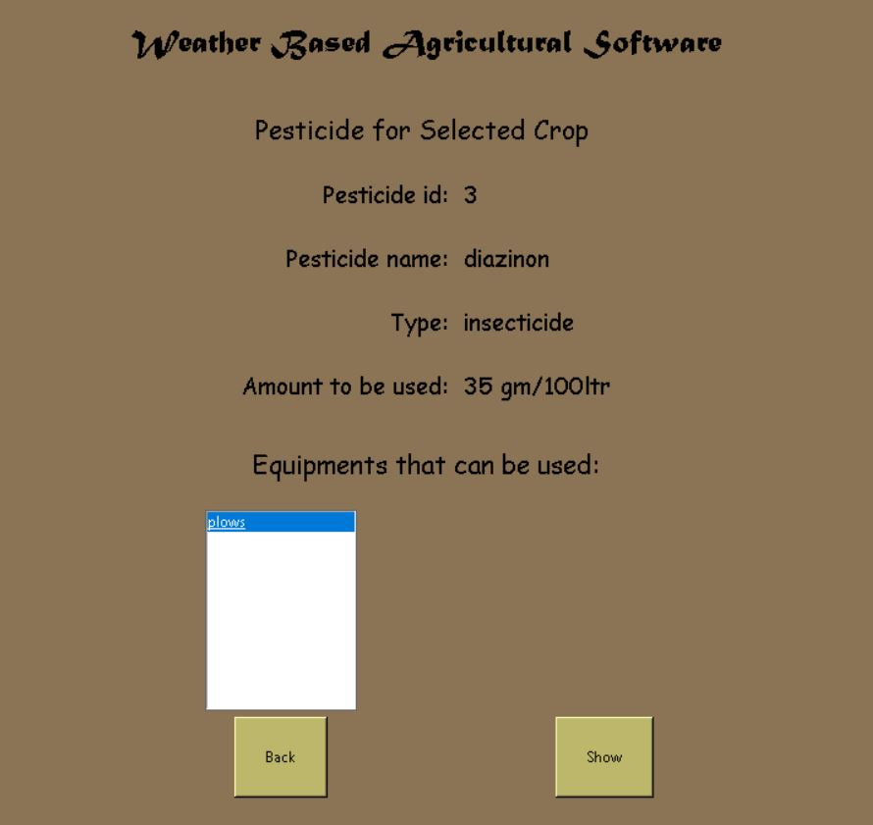
OUTCOME

Slide 13
Conclusion
According to my perspective, farmers are the ones who need our help the most.
Increasing grain today is like fulfilling our tomorrows’ stomach.
So why not help the farmers with our technology. On the same hand, we can also save nature.
And I hope that this program becomes a stepping stone to start our hand in agriculture.

Slide 14
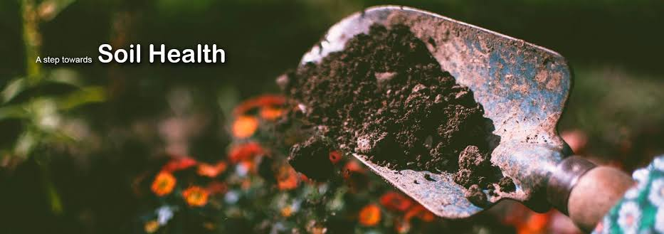
THANK YOU

